Slide 1




CST 347 – Real Time OS
Lecture 13 – Synchronization II
Troy Scevers

Slide 2
Topics
Mutex Locks
Semaphores
FreeRTOS
  Critical Sections
  MUTEX
  Semaphore

Slide 3
Solution to Critical-section Problem Using Locks
do {
acquire lock
critical section
release lock
remainder section
} while (TRUE);

Slide 4
test_and_set Instruction
Definition:
bool test_and_set (bool *target)
{
bool rv = *target;
*target = TRUE;
return rv;
}

Slide 5
Solution using test_and_set()
Shared boolean variable lock, initialized to FALSE
Solution:
do {
while (test_and_set(&lock)); /* do nothing */
/* critical section */
lock = false;
/* remainder section */
} while (true);

Slide 6
compare_and_swap Instruction
Definition:
int compare_and_swap(int *value, int expected, int new_value)
{
int temp = *value;
if (*value == expected)
*value = new_value;
return temp;
}

Slide 7
Solution using compare_and_swap
Shared Boolean variable lock initialized to FALSE
  Each process has a local Boolean variable key
Solution:
do {
while (compare_and_swap(&lock, 0, 1) != 0); /* do nothing */
/* critical section */
lock = 0;
/* remainder section */
} while (true);

Slide 8
Bounded-waiting Mutual Exclusion with test_and_set
do
{
waiting[i] = true;
key = true;
while (waiting[i] && key)
key = test_and_set(&lock);
waiting[i] = false;
/* critical section */
j = (i + 1) % n;
while ((j != i) && !waiting[j])
j = (j + 1) % n;
if (j == i)
lock = false;
else
waiting[j] = false;
/* remainder section */
} while (true);

Slide 9
Mutex Locks
Previous solutions are complicated and generally inaccessible to application programmers
OS designers build software tools to solve critical section problem
Simplest is mutex lock
Product critical regions with it by first acquire() a lock then release() it
  Boolean variable indicating if lock is available or not
Calls to acquire() and release() must be atomic
  Usually implemented via hardware atomic instructions
But this solution requires busy waiting
  This lock therefore called a spinlock

Slide 10
acquire() and release()
acquire()
{
while (!available); /* busy wait */
available = false;
}
release()
{
available = true;
}
do
{
acquire lock
critical section
release lock
remainder section
} while (true);

Slide 11
Semaphore
Synchronization tool that does not require busy waiting
Semaphore S – integer variable
Two standard operations modify S: wait() and signal()
  Originally called P() and V()
Less complicated
Can only be accessed via two indivisible (atomic) operations
wait (S)
{
while (S <= 0); // busy wait
S--;
}
signal (S)
{
S++;
}

Slide 12
Semaphore Usage
Counting semaphore – integer value can range over an unrestricted domain
Binary semaphore – integer value can range only between 0 and 1
  Then a mutex lock
Can implement a counting semaphore S as a binary semaphore
Can solve various synchronization problems
Consider P₁ and P₂ that require S₁ to happen before S₂
P1:
S₁;
signal(synch);
P2:
wait(synch);
S₂;

Slide 13
Semaphore Implementation
Must guarantee that no two processes can execute wait() and signal() on the same semaphore at the same time
Thus, implementation becomes the critical section problem where the wait and signal code are placed in the critical section
  Could now have busy waiting in critical section implementation
    But implementation code is short
    Little busy waiting if critical section rarely occupied
Note that applications may spend lots of time in critical sections and therefore this is not a good solution

Slide 14
Semaphore Implementation with no Busy waiting
With each semaphore there is an associated waiting queue
Each entry in a waiting queue has two data items:
  value (of type integer)
  pointer to next record in the list
Two operations:
  block – place the process invoking the operation on the appropriate waiting queue
  wakeup – remove one of processes in the waiting queue and place it in the ready queue

Slide 15
Semaphore Implementation with no Busy waiting (Cont.)
typedef struct process
{
int value;
struct process *list;
} semaphore;
wait(semaphore *S)
{
S->value--;
if (S->value < 0)
{
add this process to S->list;
block();
}
}
signal(semaphore *S)
{
S->value++;
if (S->value <= 0)
{
remove a process P from S->list;
wakeup(P);
}
}

Slide 16
FreeRTOS – Critical Sections
Basic Critical Sections
  Basic critical sections are regions of code that are surrounded by calls to the macros
  taskENTER_CRITICAL() and taskEXIT_CRITICAL(), respectively
Critical sections are also known as critical regions.

Slide 17
FreeRTOS – Critical Sections
/* Ensure access to the PORTA register cannot be interrupted by placing it within a critical section. Enter the critical section. */
taskENTER_CRITICAL();
/* A switch to another task cannot occur between the call to taskENTER_CRITICAL() and the call to taskEXIT_CRITICAL(). Interrupts may still execute, but only interrupts whose priority is above the value assigned to the configMAX_SYSCALL_INTERRUPT_PRIORITY constant – and those interrupts are not permitted to call FreeRTOS API functions. */
PORTA |= 0x01;
/* Access to PORTA is complete so the critical section can be exited. */
taskEXIT_CRITICAL();

Slide 18
FreeRTOS – Critical Sections
Critical sections can also be created by suspending the scheduler
  Suspending the scheduler is sometimes also known as ‘locking’ the scheduler
Basic critical sections protect a region of code from access by other tasks and by interrupts
  A critical section implemented by suspending the scheduler protects a region of code only from access by other tasks because interrupts remain enabled
  A critical section that is too long to be implemented by simply disabling interrupts can, instead, be implemented by suspending the scheduler
    However, resuming (or ‘unsuspending’) the scheduler can be a relatively long operation, so consideration must be given to which is the best method to use in each case

Slide 19
FreeRTOS – Critical Sections
void vTaskSuspendAll(void);
  The vTaskSuspendAll() API function prototype
  Suspending the scheduler prevents a context switch from occurring but leaves interrupts enabled. If an interrupt requests a context switch while the scheduler is suspended, then the request is held pending and is performed only when the scheduler is resumed (unsuspended).
FreeRTOS API functions should not be called while the scheduler is suspended

Slide 20
FreeRTOS – Critical Sections
portBASE_TYPE xTaskResumeAll(void);
  The xTaskResumeAll() API function prototype
    Returned Value Description
      Returned value Context switches that are requested while the scheduler is suspended are held pending and performed only as the scheduler is being resumed.
      A previously pending context switch being performed before xTaskResumeAll() returns results in the function returning pdTRUE.
      In all other cases, xTaskResumeAll() returns pdFALSE.
  It is safe for calls to vTaskSuspendAll() and xTaskResumeAll() to become nested, because the kernel keeps a count of the nesting depth. The scheduler will be resumed only when the nesting depth returns to zero—which is when one call to xTaskResumeAll() has been executed for every preceding call to vTaskSuspendAll().

Slide 21
FreeRTOS – Mutexes
A Mutex is a special type of binary semaphore that is used to control access to a resource that is shared between two or more tasks
  The word MUTEX originates from ‘MUTual Exclusion'.
  When used in a mutual exclusion scenario, the mutex can be thought of as a token that is associated with the resource being shared.
    For a task to access the resource legitimately, it must first successfully ‘take’ the token (be the token holder). When the token holder has finished with the resource, it must ‘give’ the token back.
    Only when the token has been returned can another task successfully take the token and then safely access the same shared resource.
    A task is not permitted to access the shared resource unless it holds the token.
Even though mutexes and binary semaphores share many characteristics
  The primary difference is what happens to the semaphore after it has been obtained:
    A semaphore that is used for mutual exclusion must always be returned.
    A semaphore that is used for synchronization is normally discarded and not returned

Slide 22
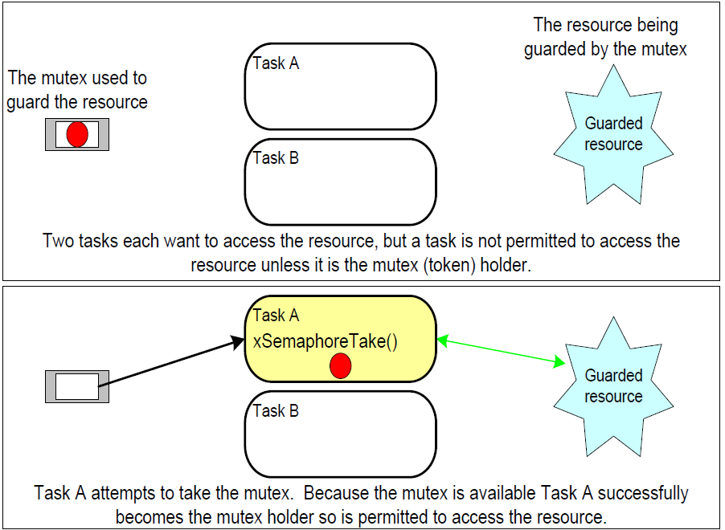
FreeRTOS – Mutexes

Slide 23
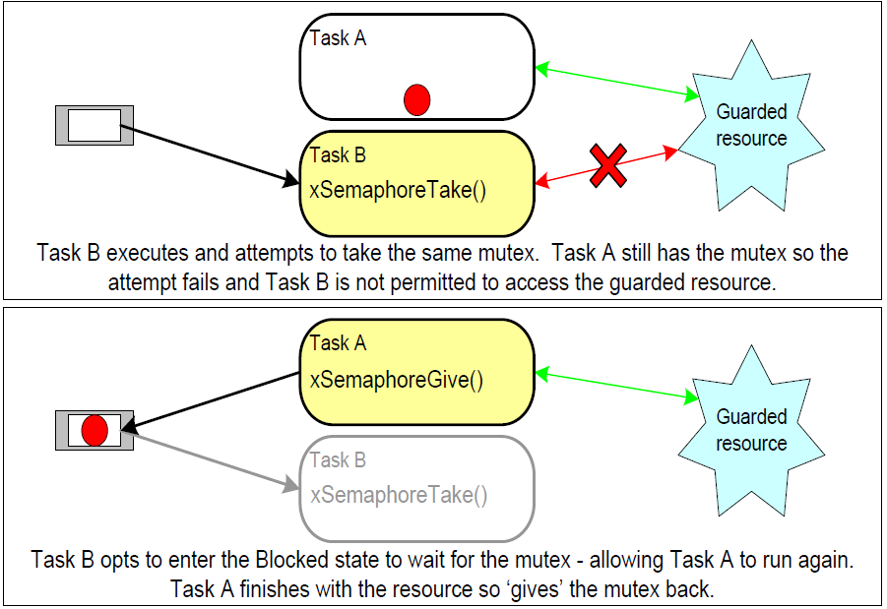
FreeRTOS – Mutexes

Slide 24
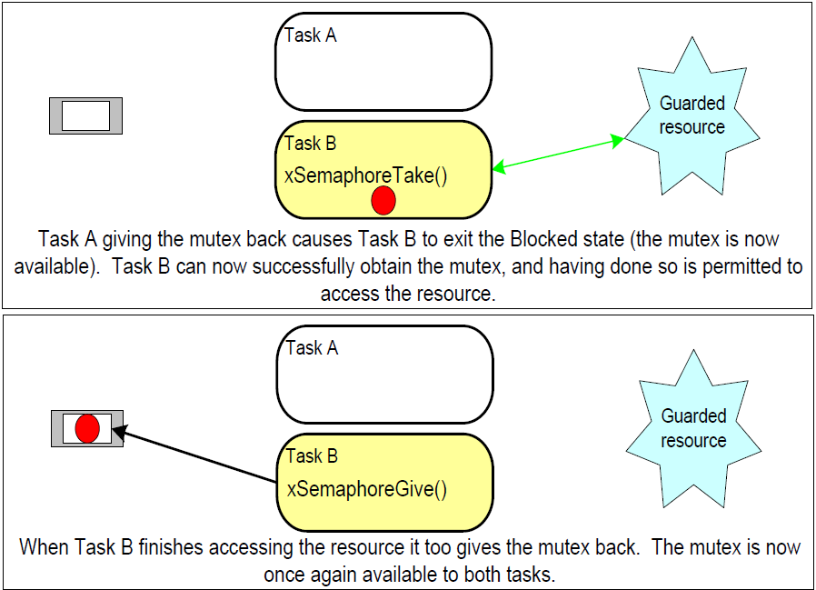
FreeRTOS – Mutexes

Slide 25
FreeRTOS – Mutexes
The xSemaphoreCreateMutex() API Function
  A mutex is a type of semaphore
  Handles to all the various types of FreeRTOS semaphore are stored in a variable of type xSemaphoreHandle
  Before a mutex can be used, it must be created. To create a mutex type semaphore, use the xSemaphoreCreateMutex() API function.
xSemaphoreHandle xSemaphoreCreateMutex(void);
  xSemaphoreCreateMutex() return value
      Returned Value
        If NULL is returned, then the mutex could not be created because there is insufficient heap memory available for FreeRTOS to allocate the mutex data structures
        A non-NULL return value indicates that the mutex has been created successfully
        The returned value should be stored as the handle to the created mutex.

Slide 26
FreeRTOS – Semaphores
The vSemaphoreCreateBinary() API Function
  Handles to all the various types of FreeRTOS semaphore are stored in a variable of type xSemaphoreHandle
  Before a semaphore can be used, it must be created
  To create a binary semaphore, use the vSemaphoreCreateBinary() API function
void vSemaphoreCreateBinary(xSemaphoreHandle xSemaphore);
  vSemaphoreCreateBinary() parameters
    xSemaphore The semaphore being created.
Note that vSemaphoreCreateBinary() is actually implemented as a macro, so the semaphore variable should be passed in directly, rather than by reference

Slide 27
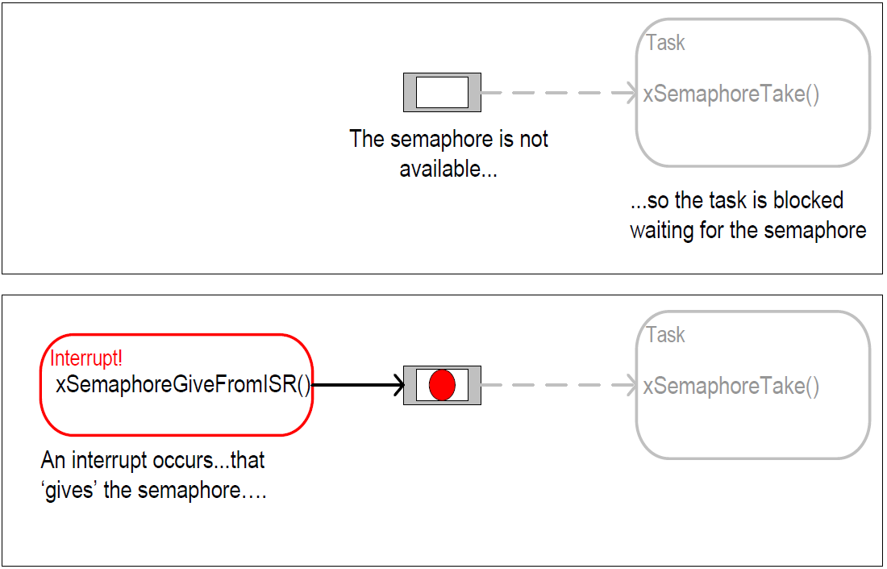
FreeRTOS – Semaphores

Slide 28
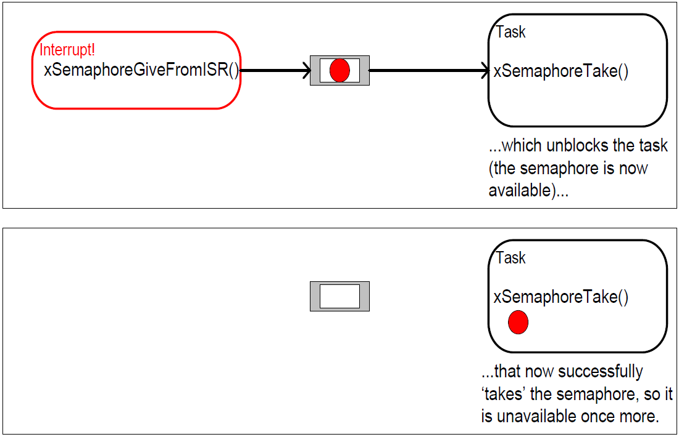
FreeRTOS – Semaphores

Slide 29
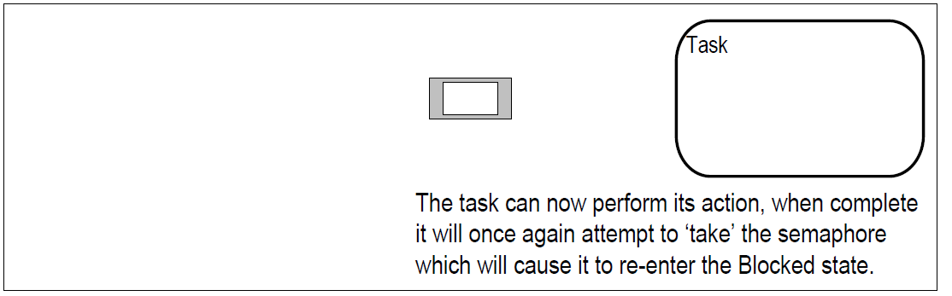
FreeRTOS – Semaphores

Slide 30
FreeRTOS – Semaphores
The xSemaphoreTake() API Function
  ‘Taking’ a semaphore means to ‘obtain’ or ‘receive’ the semaphore
  The semaphore can be taken only if it is available
    In classic semaphore terminology, xSemaphoreTake() is equivalent to a P() operation.
  All the various types of FreeRTOS semaphore, except recursive semaphores, can be ‘taken’ using the xSemaphoreTake() function.
  xSemaphoreTake() must not be used from an interrupt service routine.
portBASE_TYPE xSemaphoreTake( xSemaphoreHandle xSemaphore, portTickType xTicksToWait );

Slide 31
FreeRTOS – Semaphores
FreeRTOS API
  vSemaphoreCreateBinary()
  xSemaphoreCreateCounting()
  xSemaphoreCreateMutex()
  vSemaphoreDelete()
  xSemaphoreGive()
  xSemaphoreTake()
  xSemaphoreGiveFromISR()
  xSemaphoreTakeFromISR()

Slide 32
FreeRTOS – Semaphores
Counting Semaphores
  Just as binary semaphores can be thought of as queues having a length of one
  Counting semaphores can be thought of as queues having a length of more than one
  Tasks are not interested in the data that is stored in the queue—just whether the queue is empty or not.
  Each time a counting semaphore is ‘given’, another space in its queue is used
    The number of items in the queue is the semaphore’s ‘count’ value.
    configUSE_COUNTING_SEMAPHORES must be set to 1 in FreeRTOSConfig.h for counting semaphores to be available.

Slide 33
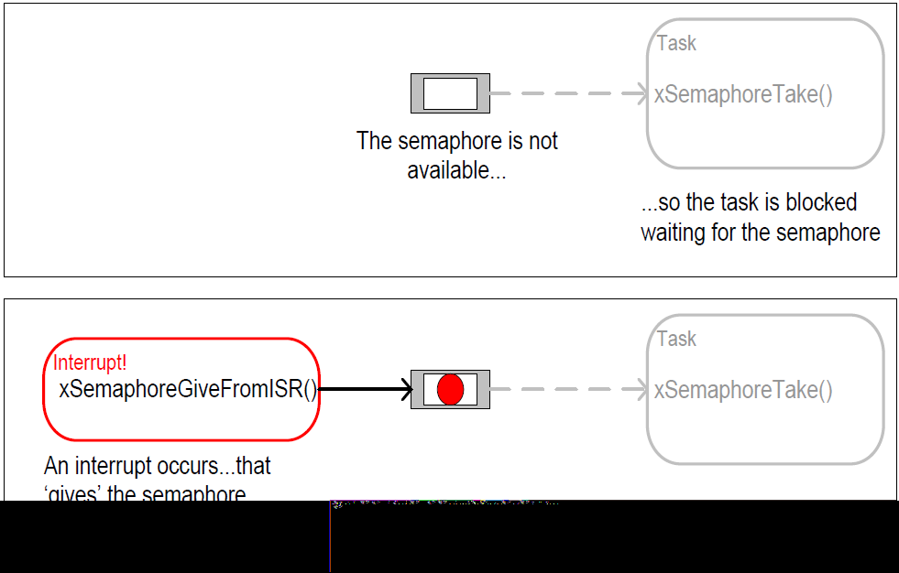
FreeRTOS – Semaphores

Slide 34
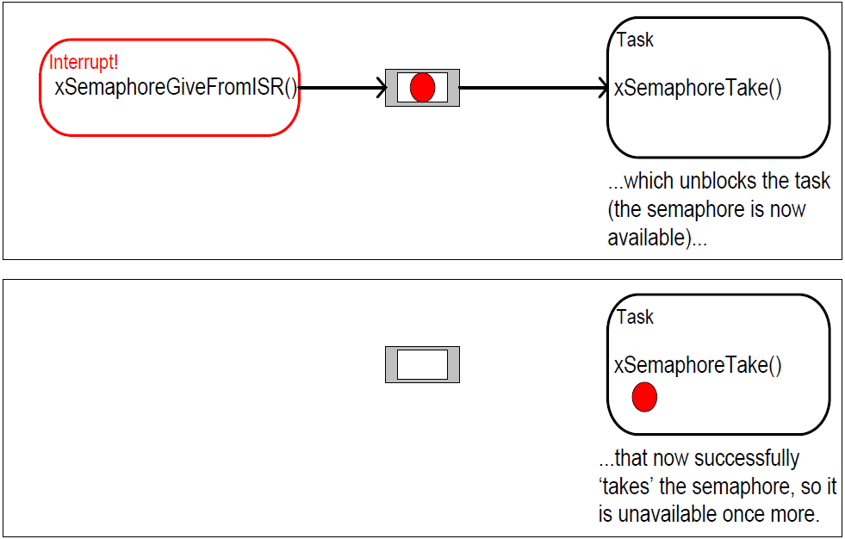
FreeRTOS – Semaphores

Slide 35
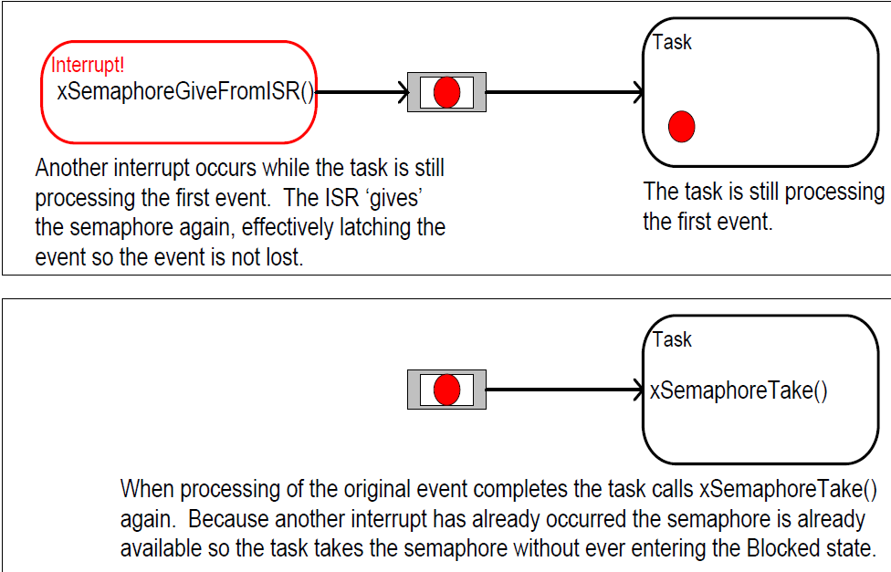
FreeRTOS – Semaphores

Slide 36
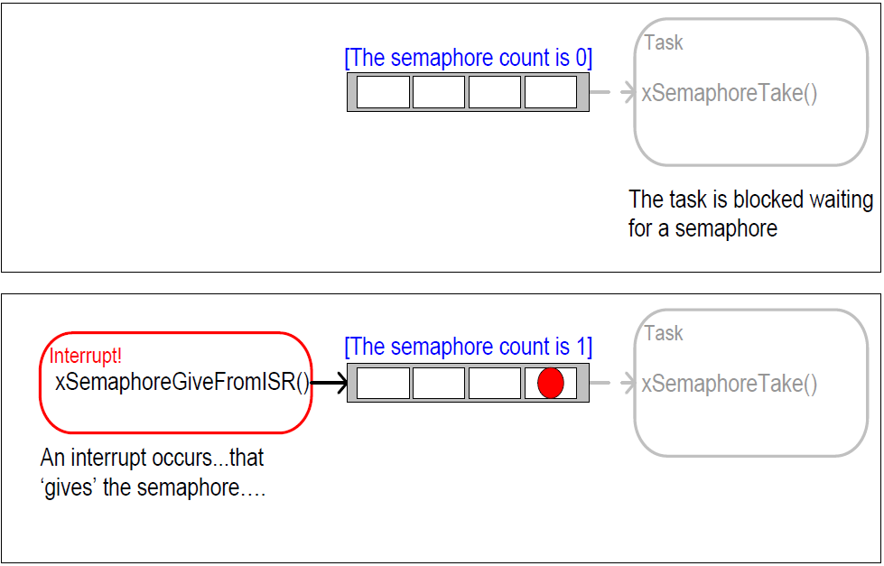
FreeRTOS – Semaphores

Slide 37
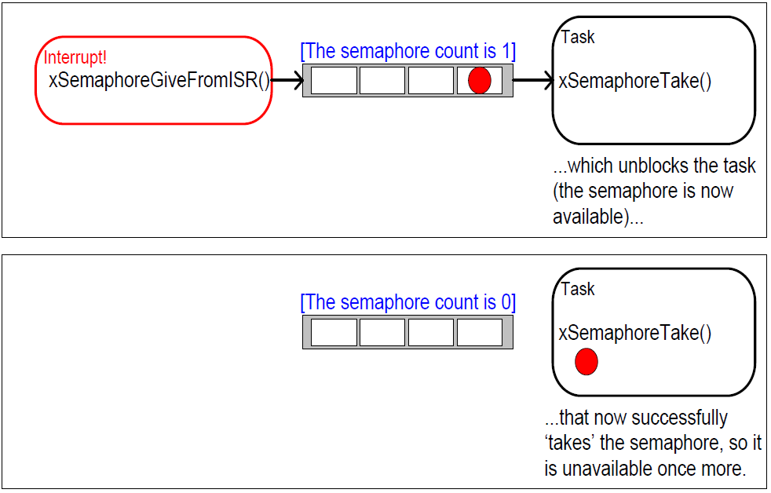
FreeRTOS – Semaphores

Slide 38
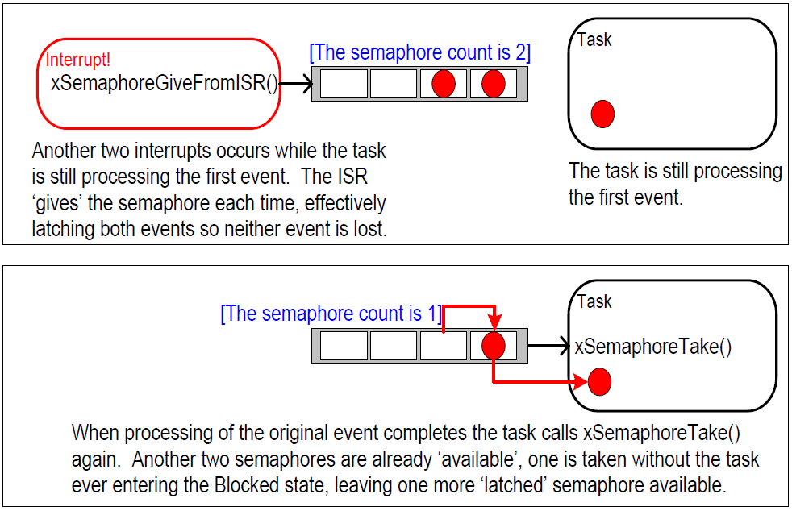
FreeRTOS – Semaphores

Slide 39
FreeRTOS
Using Queues within an Interrupt Service Routine
  xQueueSendToFrontFromISR()
  xQueueSendToBackFromISR()
  xQueueReceiveFromISR()
    are versions of xQueueSendToFront(), xQueueSendToBack() and xQueueReceive(), respectively, that are safe to use within an interrupt service routine.
Semaphores are used to communicate events. Queues are used to communicate events and to transfer data.

